Slide 1

Eniac & Magist: Breakout into Brazil Market?
"Dieses Foto" von Unbekannter Autor ist lizenziert gemäß CC BY

Slide 2
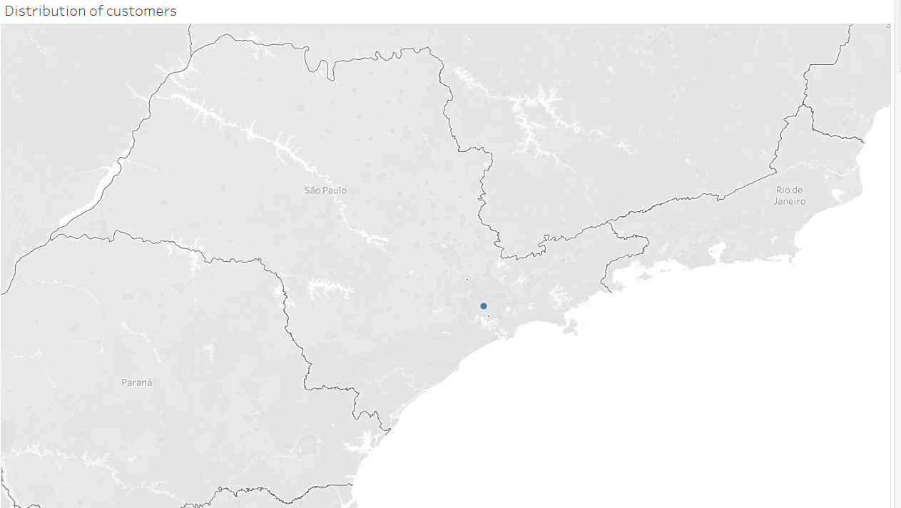
Agenda
Problem
Magist: Facts & Fields
Product
Overview
Orders
Delivery
Conclusion
Sellers

Slide 3


Magist a suitable business partner?
Is Magist a good fit for high-end tech products?
Are orders delivered on time?

Slide 4
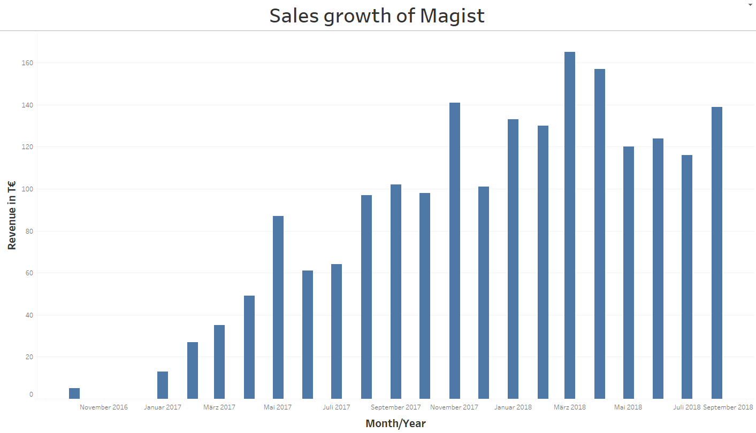
Magist: Facts & Fields
Data of Magist:
09-2016 till 10 -2018
Overall growth in sales from 2016 till 2018

Slide 5
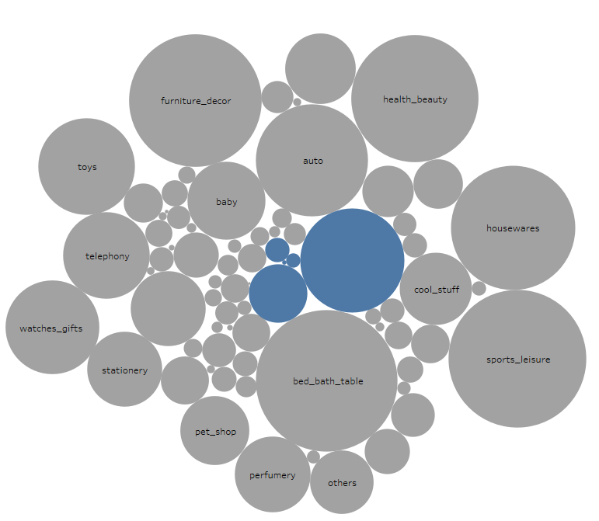
Product Overview
~ 33.000 different products
Majority are domestic products
12% Tech products
Computer_accessories
electronics

Slide 6


Sellers of Magist
3095 Sellers on Magist
15 % are Tech Sellers
Tech sellers earn ~ 890 € a month compared to all (~170€) or just non-tech sellers(~35€)

Slide 7

Orders: Revenue
Total ~ 100.000 orders
Avg. tech order purchase ~ 220 €
Magist average Tech product price 148 €
Eniac average product price 540 €
Eniac average Tech order price 710 €

Slide 8
97% delivered orders
(All products)
98% delivered orders
(Tech products)
2800 Tech products >200 € 21% of all products > 200%)
273 Tech products > 1000 € (32% of all products > 1000 €)

Slide 9
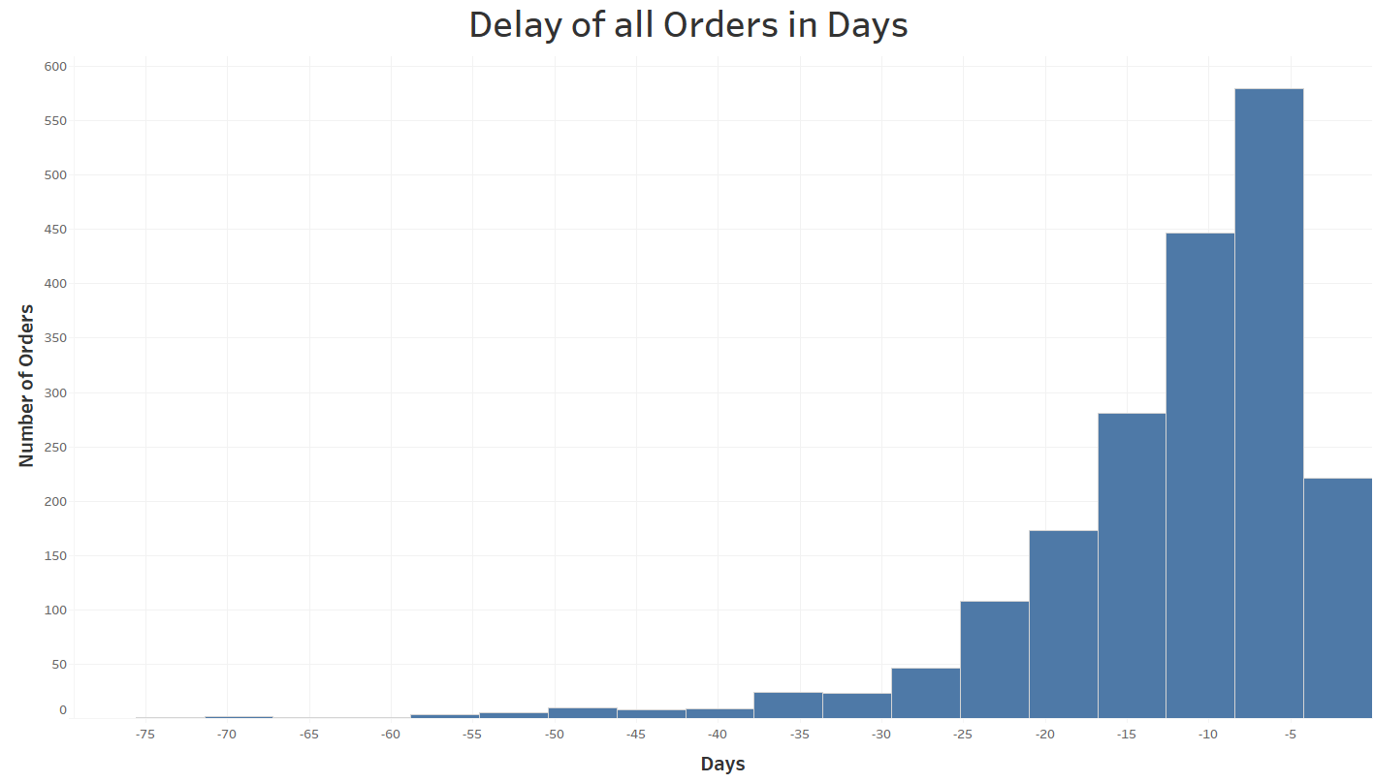
Order Delivery
~ 8 days
Delay of ~ 8 days (All products)
Delay of ~ 13 days (Tech products)

Slide 10
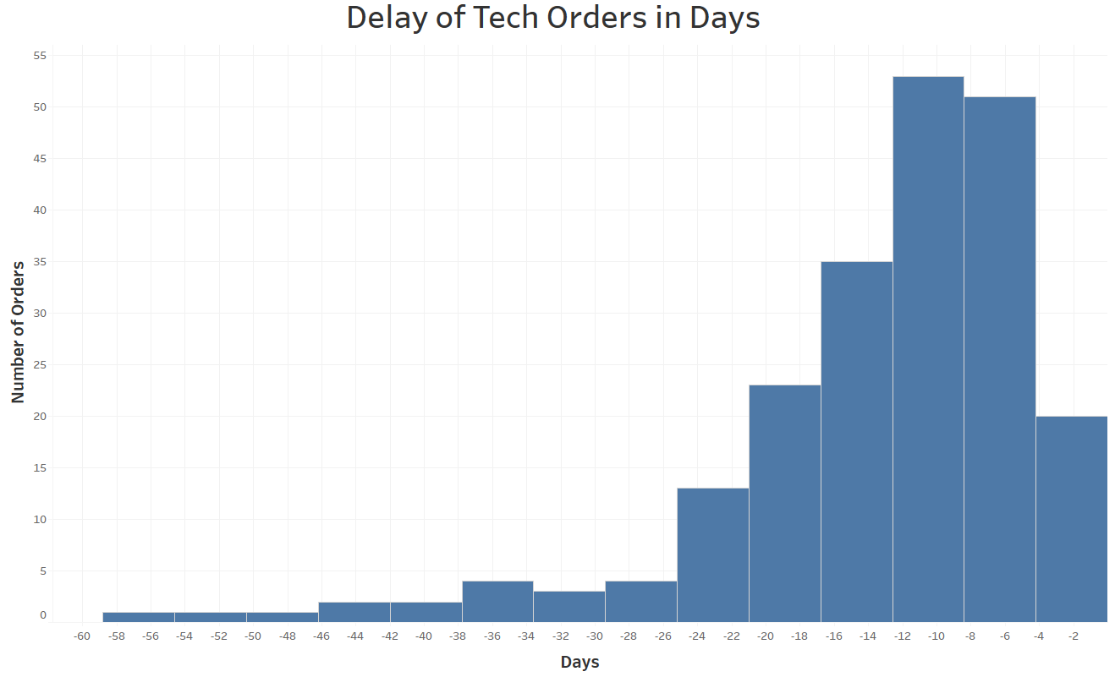
Order Delivery
~ 13 days
Delay of ~ 8 days (All products)
Delay of ~ 13 days (Tech products)

Slide 11
Magist a suitable business partner?

Slide 12
Magist a suitable business partner?
Is Magist a good fit for high-end tech products?

Slide 13
Magist a suitable business partner?
No, because..
Not the platform for high-end products
Not tech-focused products
Not enough Tech-sellers
Is Magist a good fit for high-end tech products?

Slide 14
Magist a suitable business partner?
No, because..
Not the platform for high-end products
Not tech-focused products
Not enough Tech-sellers
Is Magist a good fit for high-end tech products?
Are orders delivered on time?

Slide 15
Magist a suitable business partner?
No, because..
Not the platform for high-end products
Not tech-focused products
Not enough Tech-sellers
Is Magist a good fit for high-end tech products?
Are orders delivered on time?
No, because…
An average of 8-13 days of order delay

Slide 16

Alternative to Magist
Grupo Alcateia
Aldo
All Nations
Largest IT Distributors
More than 30 years in business
Operates in different countries

Slide 17
Magist a suitable business partner?
No, because..
Not the platform for high-end products
Not tech-focused products
Not enough Tech-sellers
Is Magist a good fit for high-end tech products?
Are orders delivered on time?
No, because…
An average of 8-13 days of order delay

Slide 18
Feedback
Slide with the problems // Why are we here?
A little agenda
More answers to the business questions
All products vs. Tech products
Axis name of the charts
Slide No.2: Legend – total number of products cat. & tech products cat.
Slide No. 5 Answer to the questions

Slide 19
Distribution of costumers

